Slide 1

Introduction to Philosophy of Medicine
Hamidreza Namazi
MD.MS.PHD
Department of Medical Ethics
Tehran University of Medical Sciences

Slide 2
History of Philosophy of Medicine
Galenus, Hippocrates (Essence of Disease)
Socrates, Plato (Technical effort in the light of ethical considerations)
Avicenna, Razes (Between Empiricism and Rationalism)
Thomas Sydenham (Empiricism in Medicine)
Gilbert Blane (Elements of Medical Logic:1822)
Ludwig Fleck (Collective Thought, Rethinking Disease : Relativism) / Thomas Cohn : Paradigm
Tristam Engelhardt , Edmund Pellegrino (The Journal of Medicine and Philosophy :1976)
Analytic Philosophy of Medicine (Kazem Sadeghzadeh)
Continental Philosophy of Medicine ( Foucault, Gadamer, Heidegger,… )

Slide 3
Five Relationships Between Philosophy and Medicine
Folk Philosophy (Philosophy in the application of the common people)
Speculator( Armchair Philosophers)
Humanity Hobbyist
The Primacy of the Philosophical Method over the Scientific Method
Methodological Bridge between Philosophy and Medicine (Integrative Approach )

Slide 4
Essence of Medicine
Profession
Phronesis
Science
Art
Scientific Art

Slide 5
Analytic Philosophy of Medicine
Language of Medicine
Medical Praxiology
Medical Epistemology
Medical Deontics
Medical Logic
Medical Metaphysics

Slide 6
Continental Philosophy of Medicine
The Enigma of Health (Gadamer)
Zollicon Seminar—> Existential Medicine ( Heidegger)
Power and Medicine , The Birth of Clinic (Foucault)
Georges Canguilhem (Social Construction of Medicine, Historical Epistemology of Medicine)
Biopolitics
Ponopticon, Clinical Gaze
Psychopolitics
Death
Pressure, Pain, Suffering, Torture
…

Slide 7
Contemporary Philosophy of Medicine
Medical Ontology
Medical Epistemology
Philosophy of Medical Ethics

Slide 8
Medical Ontology
Health and Medicine
Definition of Health and Disease
Types of Relationships between Health and Disease
Realism and Anti-realism
Anti-normativism and Normativism
Medicalization and Overdiagnosis
Holistic approach to Health
…

Slide 9
Realism
Anti-normativism
Statisticism ( Median ,Randomization, P-value, …)
-Natural vs. Artificial
-Natural as Functional
-Natural as Normal
Evolutionary medicine (Distal cause vs. Proximal cause)

Slide 10
Anti-realism
Normativism
Social Construction
Confusion between Normal and Natural
Placebo Response / Nocebo Effect

Slide 11
Four Relationships between Health and Disease
Medical Model
Ideal Model
Humanistic Model
Disjunctive Model

Slide 12
The Gray zone between disease and health
Health
Illness
Sickness
Disease

Slide 13
Holistic approach to Health
Meaning of Health ( Linguistic viewpoint)
Bio-psycho-social (George Engel)
Dimensions of Health
Criticisms:
undisciplined eclecticism
Over interpretation
Insensitive to patients' subjective experience
Unfaithful to the general systems theory

Slide 14
Medicalization
Medicalization vs. overdiagnosis
From Crime to Disease
Everyday Life/ stages of life
Life Problems
Enhancement

Slide 15
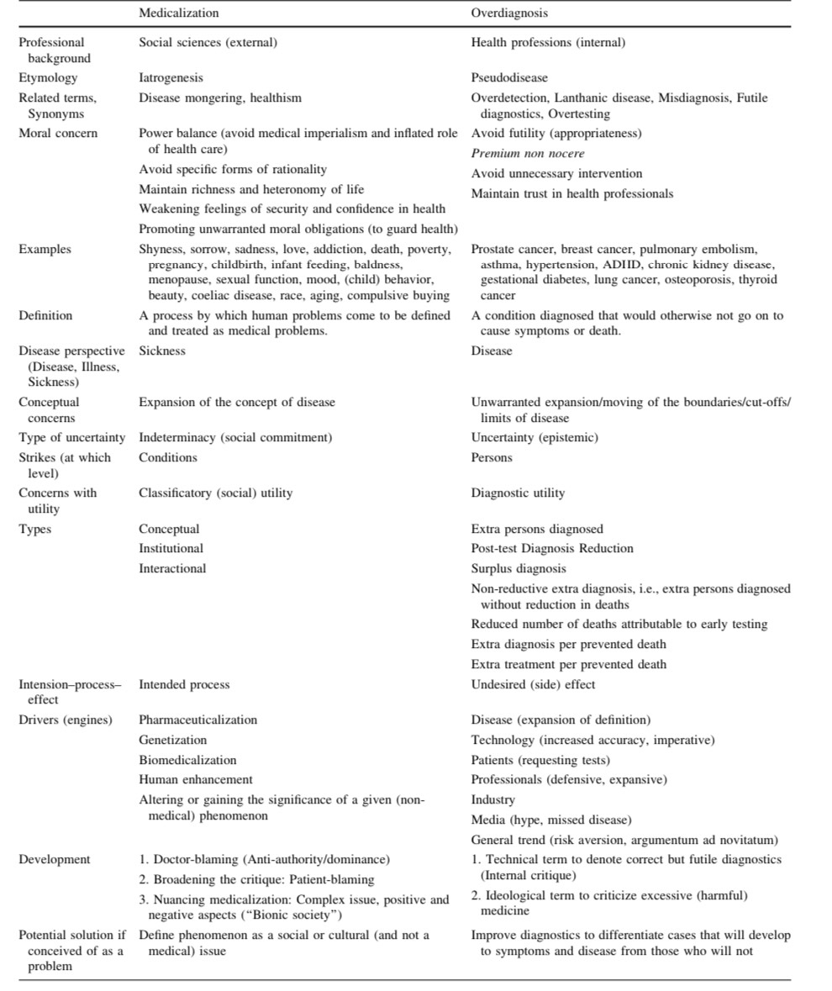

Slide 16
Medical Epistemology
Medical Decision-making
Clinical Reasoning
Cognitive Errors and Diagnostic Mistakes
Artificial Intelligence in Medicine
Incommensurability
Bayesian Theory
Philosophy of Epidemiology
Replication Crisis
Meta-research

Slide 17
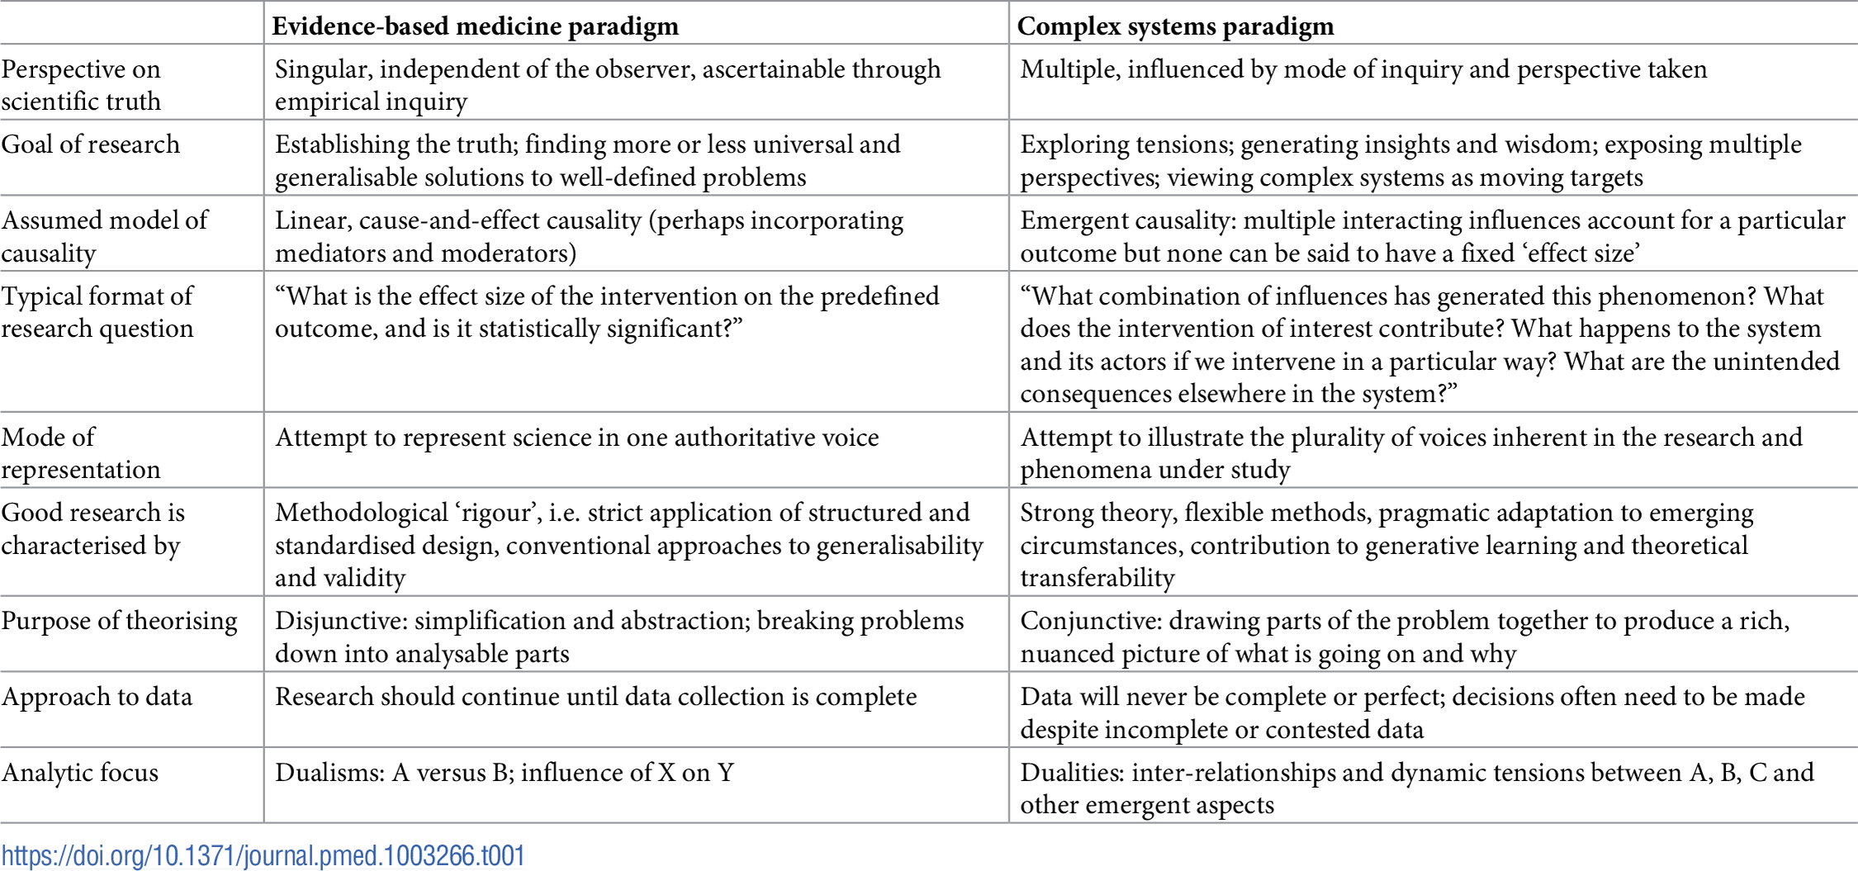
. Evidence-based medicine versus complex systems research paradigms.

